Slide 1




MIAMI[MIA]
BY: RAJARAM M

Slide 2
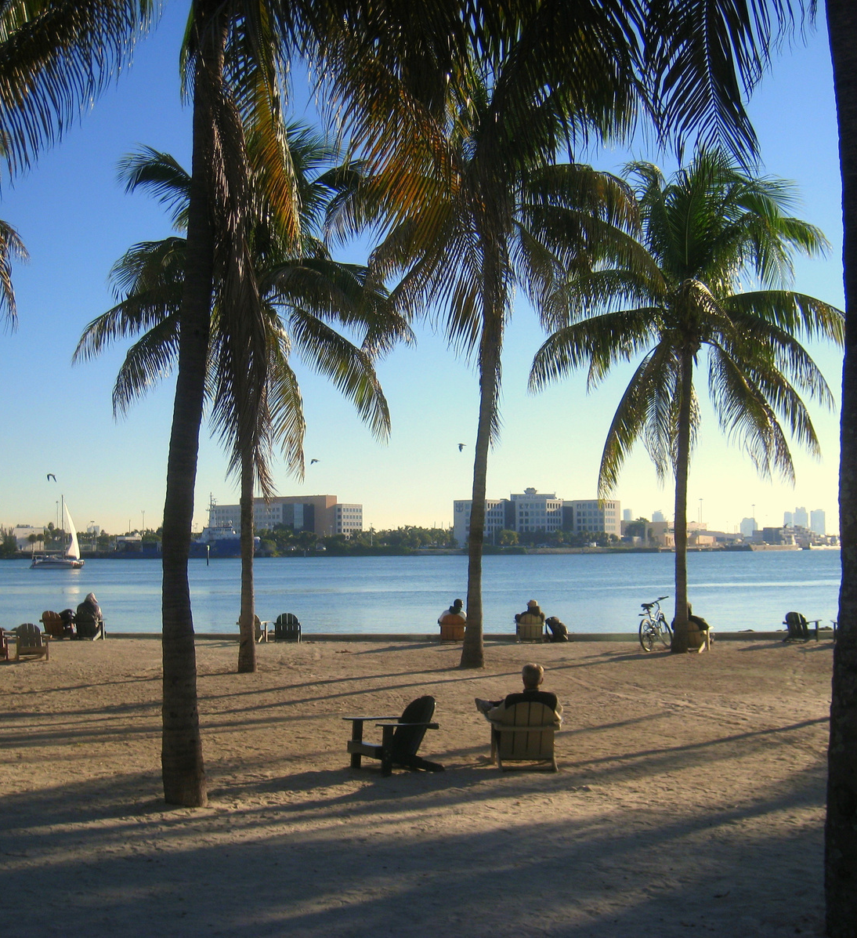
INTRODUCTION
MIAMI[MIA] , POPULATION OF 6.14 MILLION
IT IS THE SECOND-LARGEST METROPOLITAN AREA IN THE SOUTHEAST AFTER ATLANTA

Slide 3
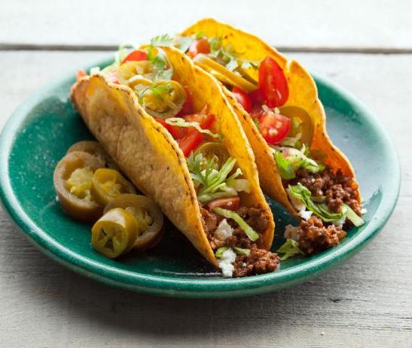
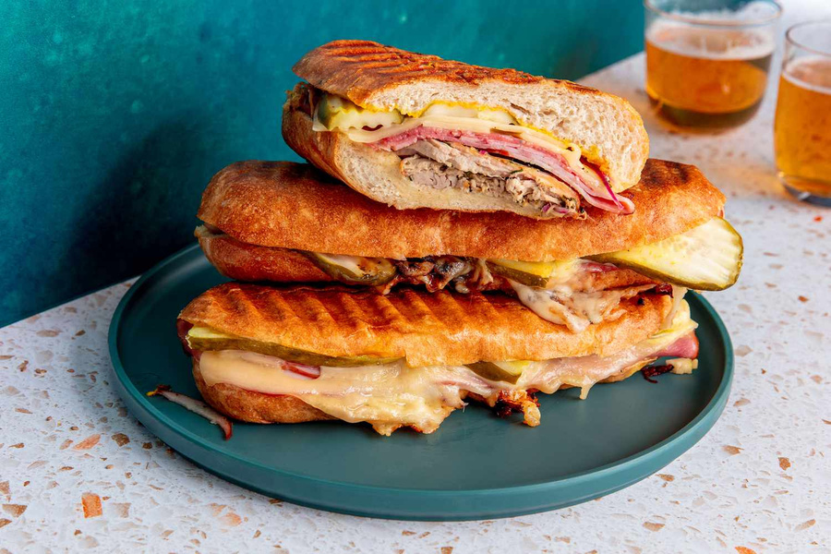
ABOUT
1 USD = 83.518501 INR
stunning beaches, vibrant nightlife, and Cuban solid influence
Great Food: especially dishes from Latin America and the Caribbean[ Taco Mania],[Cuban sandwich].
Spain Controlled Florida Until 1762
The name Miami(BIG WATER) name is from Native American – From the Calusa

Slide 4
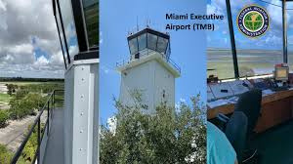
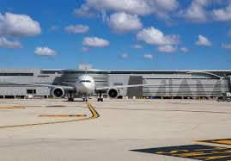
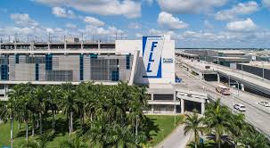
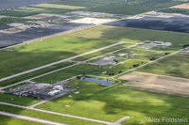
AIRPORTS
1 Miami International Airport(MIA)
3 Miami Executive Airport(TMB)
THIS IS THE PRIMARY AIRPORT SERVING MIAMI AND ITS METROPOLITANT AREA
THIS IS THE PUBLIC TRANSPORT LOCATED IN
MIAMI-DADE
2 Fort Launderdale-Hollywood International Airport(FLL)
4 Miami Homestead General Aviation Airport(X51)
WHILE TECHNICALLY NOT IN MIAMI, IT’S CLOSE ENOUGN TO SERVE THE MIAMI METROPOLITAN AREA
THIS IS THE PUBLIC TRANSPORT LOCATED IN HOMESTAD MIAMI

Slide 5
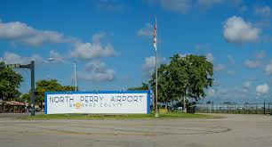
AIRPORTS
5 North Perry Airport(HW))
THIS IS A PUBLIC AIRPORT LOCATED IN BROWARD COUNTY

Slide 6


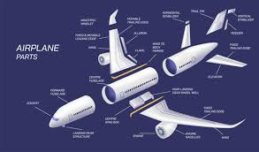
Exports
ELECTRONIC INTEGRATED CIRCUITS
AIRCRAFT PARTS
SMARTPHONES

Slide 7

Thank you

